Slide 1
Effective Strategies: Collecting High Quality Qualitative Data
Graduate Research Series
July 27th, 2023
Kwame Sakyi, MSPH, PHD
Associate Professor, Oakland University
Director: Center for Learning and Childhood Development Ghana

Slide 2
Lecture Objectives
Delineate requirements for quality qualitative research based on the Consolidated Requirement for qualitative guidelines (COREQ) Criteria
Discuss practical strategies to collect rich, reliable, qualitative data

Slide 3
Different layers of quality: Qualitative Research
Best practices of quality for each dimension
Conceptualization
Sampling and Data Collection
Analysis and Reflexivity
Dissemination
Qualitative Criteria (e.g. credibility, dependability, confirmability, trustworthiness)
Notes:
Academic conceptualization of quality encompasses multiple dimensions of qualitative research. There are best practices of quality procedures that

Slide 4
Quality?
In the end
Rich description
Balanced, contextual understanding
Learn lessons
Resonates
Representative of individual lived experience

Slide 5
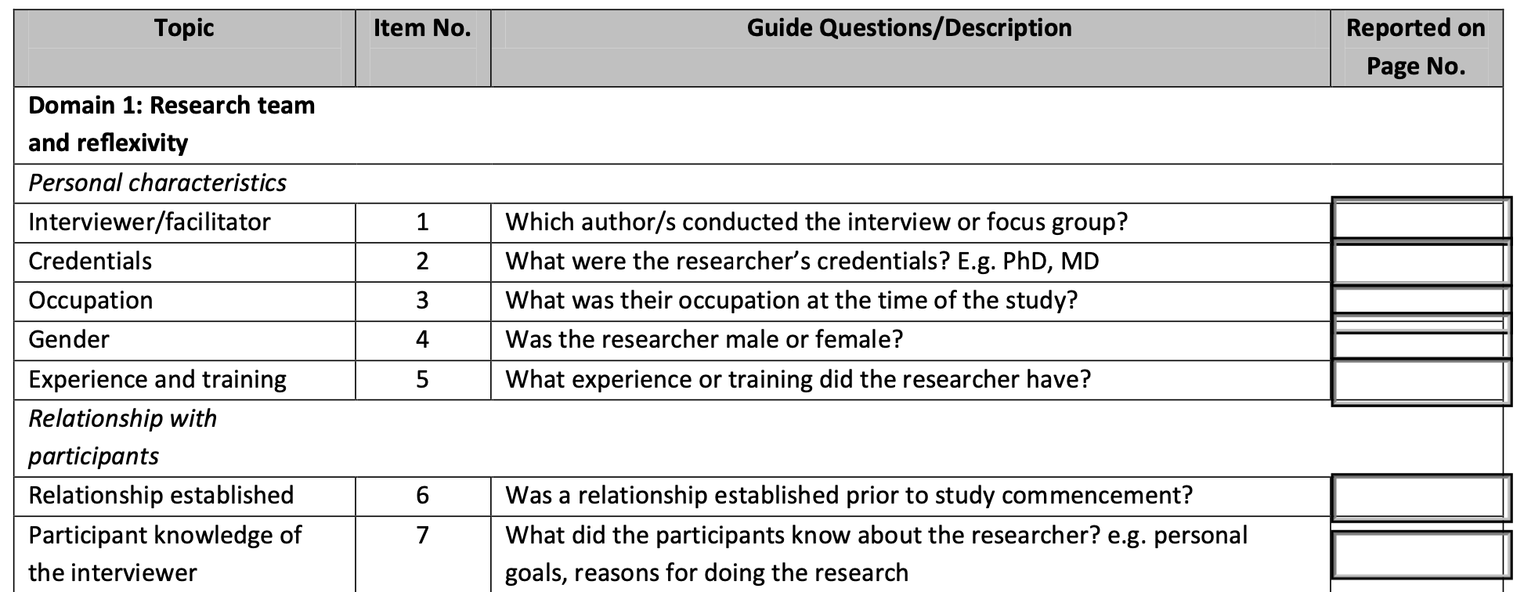
Consolidated Criteria for Reporting Qualitative Research (COREQ)
A checklist of items to guide assessment of rigorous qualitative research
Link: https://cdn.elsevier.com/promis_misc/ISSM_COREQ_Checklist.pdf

Slide 6
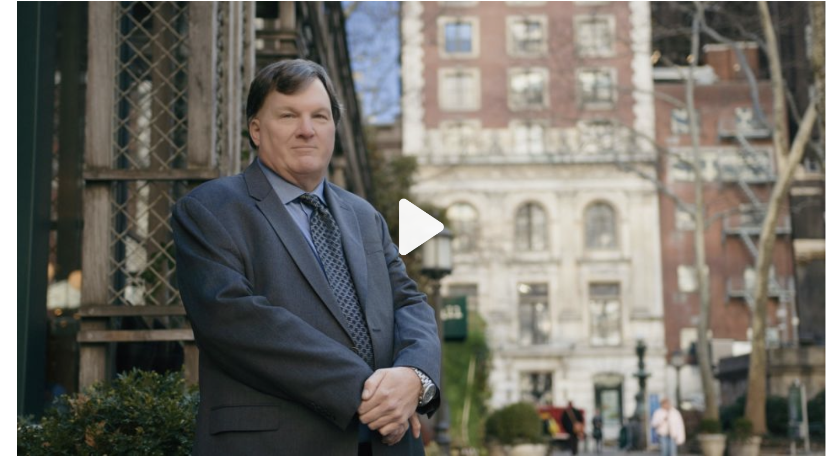
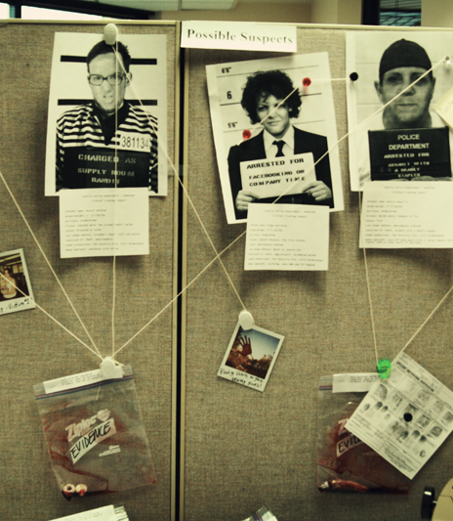
Gilgo Beach Killings
Notes:
Qualitative research is liking solving a crime
Your goal is to find the patterns and facts
Your goal is to find the motive behind people’s experience
You have to be strategic about who you interview
The best investigator follow-leads
The best investigator keeps back to the drawing broad and fine tune his theory for solving the crime

Slide 7
COREQ Criteria: Research Team
Notes:
Researcher is the instrument
Recognize that who you are can be a barrier or an asset in data collection

Slide 8
Strategy on Research Team: Be culturally Naive
Use cultural naiveté to your benefit
Pretend or express that you do not know or understand an issue and let the participant explain it to you
Example: I am a man. I have never given birth before, so I do not know what women go through when they give birth. Could you help me understand what is like to give birth at this hospital

Slide 9
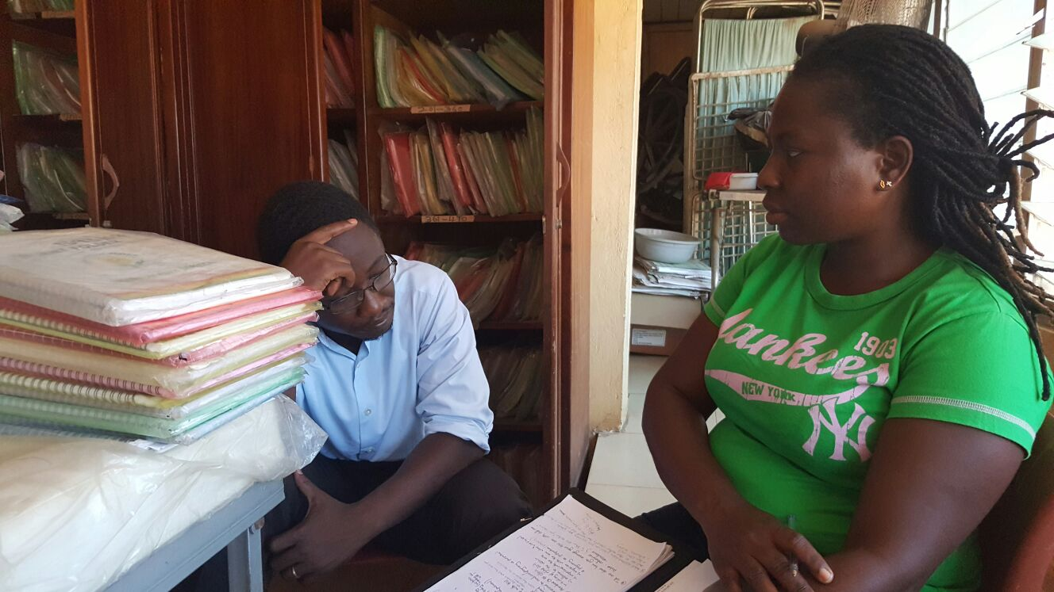
Strategy on Research Team: Give power
Make the participant feel powerful
If possible, sit on a lower chair
If you are a student or research assistant, introduce yourself as such
Respect the participant and treat the participant as an expert or “professor” of his or her experiences
Listen: Echoing probe (I heard you say, paraphrasing.

Slide 10
COREQ Criteria: Relationship with participants

Slide 11
Strategy on Relationships (1): Build rapport
Build a relationship and get informed consent
Use the Principle of Likeness and find a common ground
Be helpful where needed
Seek informed consent
If feasible, interview the best interviewee’s twice

Slide 12
Strategy on Relations (2): Ask descriptive questions
Pose or start with questions that allow participants to talk more.
E.g. Start with grand tour or narrative type questions
Interviewer: I want to understand what your experience has been living with HIV. I would like you to first start with when you found out you were HIV positive.
Participant: ….
Interviewer: Then after the diagnosis, help me understand what happened?

Slide 13
Strategy on Relationships (3): Prepare for challenging participants
Use vignettes (hypothetical situations) with participants who are not open about their experiences
Use compare and contrast questions
E.g. Could you compare the challenges you faced with taking ART during pregnancy and after childbirth?
If possible, avoid starting questions with WHY?

Slide 14
COREQ Criteria: Study design

Slide 15
Strategy on Methodology: Identify your methodological orientation
The approach to data collection may differ depending on the qualitative methodology used.
E.g.
Grounded Theory (theoretical sampling)
Phenomenology (e.g. bracketing)
Content Analysis (evaluating specific content/idea)
Ethnography (detailed observations, and prolonged data collection)
Be mindful of data collectors. They often want to change your methodology to suit what they know or think they know.

Slide 16
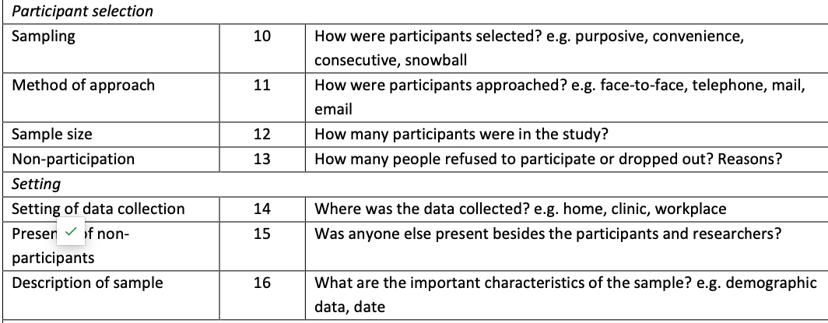
COREQ Criteria: Participant Selection

Slide 17
Strategy Participant Selection(1): Think like a murder detective
When there is a crime,
Would you not narrow down interviews to people who are familiar or related to the crime, instead of everybody? (Key informants)
Would you not be purposeful who you talk to instead of selecting randomly? (Purposive sampling)
Would you not look at multiple sources of evidence or find collaborators/alibi?(Triangulation)
Would you not talk to new people if they have relevant information? (Theoretical sampling)
Would you not stop talking to people if you have hit a dead end? (Saturation)
Would you not sometimes hide to observe people if relevant? (Observation)
Would you not provide a search warrant before you arrest? (Ethics)

Slide 18
COREQ Criteria: Data Collection

Slide 19
Strategy on Data Collection (1): Still think like a murder detective
Would you ask everybody the same question regardless of what they know or have to say about the case?
So,
Keep some questions consistent, but tailor it to the participant
Follow leads

Slide 20
Strategy on Data Collection (1): Train and Pilot test
Training and pilot testing of interview and discussion guides
Understand the main objectives of the research
Interview with the guide among your study team first before pilot testing
Boil the questions down to 3-5 major ones (that you can remember)
Focus on the sequence/flow rather than categories of questions
Prepare before you go for the interview
Notes:
A quality product starts at the assembly like. A good investigator protects the crime scene. Before they start collecting data, what do they do, they bar the place off.
It is important that you and your team know at your finger tips the goal of the study and what they can’t miss asking people
Interview with the guide among your study team, including yourself. It is easy to train, but it is not easy to be vulnerable. You need to do it to get the kinks out
Rather than having twenty questions, make sure you have five key questions. Imagine you have 5-10 minutes for an interview what will you ask? Think of interviewing midwives or doctors? Or a mother who has to go to a market
When you do the pilot testing, look for two things: the wording of the question and the sequence or flow of the questions

Slide 21
Strategy on Data Collection (2): Listen to the interviews
Listen to the audio recording right after the interview
Listen to team members’ interviews and your own. Look for
Tone of voice
How questions are phrased?
Missed opportunities for further questions?
How much you talk!
Notes:
Listening makes you learn about
How to better phrase questions
Areas that you are not probing
How dominant you are in the interview
Areas that you are not probing
Debriefing
Allows you to begin to chart your understanding about the problem
Helps interviewers know what you are looking for and why?

Slide 22
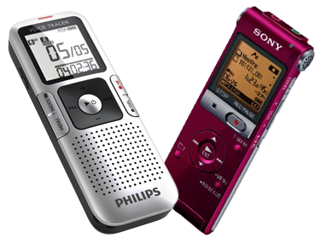
Strategy on Data Collection (3): Probe! Probe! Probe!
Probe to get more insight (examples)
Help me understand (cultural naiveté)
Really!
I see
Tell me more
Silence
Tell me a story about…
Hmm

Slide 23
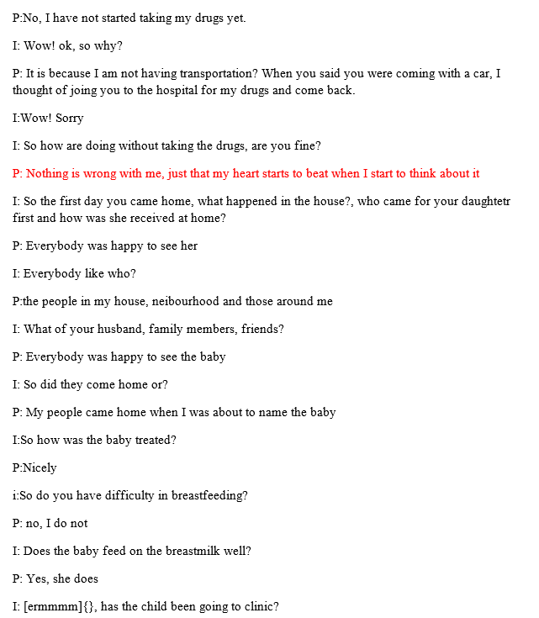
Sample Interview 1: before listening to audio recording
Notes:
Compare two transcripts

Slide 24
What stood out to you?
How did the interview make you feel?
Notes:
Compare two transcripts

Slide 25
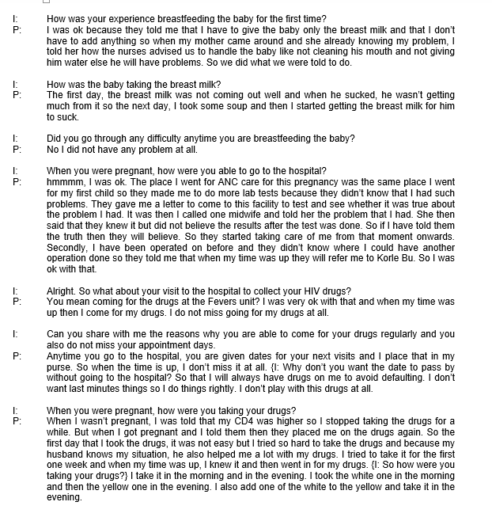
Sample Interview After listening to audio recording

Slide 26
Strategy on Data Collection (4): Do not wait until the end to analyse
Debrief with your team
Describe each participant’s experience
Interrogate the interviewers about participants’ experiences
Revise questions to elicit deeper descriptions
Write theoretical, methodological or analytical memos
Summarize each participant’s experience
Answer the research question based on each participant’s interview

Slide 27
Interviewing interviewers

Slide 28
If you do your work well: You will
Have a rich description of participants’ experiences
A balanced, contextual understanding (why)
Others can learn lessons
Descriptions will resonate with others
Have representation of individual lived experience
Get published
Notes:
Indepth description
They are really interested in the context where people experiences occur—interested in who, where and how? Does the phenomenon only relates to men
They want to know if the findings are transferable to other settings
They are interested in representing participant’s views more so than the researcher’s own—So they will use quotes than numbers
They are also interested in finding meaning in experiences.. So not only description, but why? Why do people smoke even know they know it is harmful? Why do people defecate outside even when there is latrine? Why do midwives not treat women with respect?
Like a jury in a court, a good explanatory framework will allow an outsiders or others to evaluate if the findings resonate. Is this possible? Does the evidence points to that?

Slide 29
Questions

